Slide 1
Steganography Technique Based On Block-DCT And Huffman Encoding
Zachary Salazar, Marvin Lopez, Marcus Lorenzana

Slide 2
“A novel technique for image steganography based on Block-DCT and Huffman Encoding”
Changed it to work for bitmap.
The technique for image steganography involved Huffman Encoding, Discrete Cosine Transform(DCT), and Least Significant Bit(LSB).

Slide 3
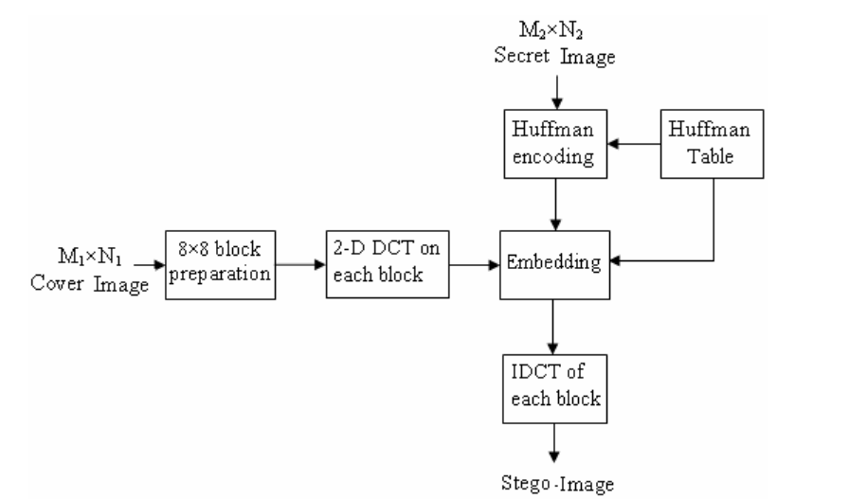
Insertion:

Slide 4
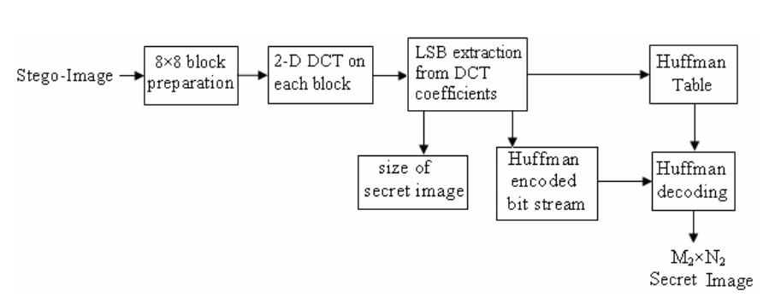
Extraction:

Slide 5


DCT
In the project we generate 8x8 pixels blocks of the image then we apply the DCT coeficients so we can modify and apply are hidden image. we also used the IDCT to get the pixels back to generate the picture.

Slide 6
DCT
In are program we made three functions to manipulate the array of 8x8 pixels the first is
Compute8x8Dct(double in[][],double out[][])
This function gets the 2-d array in[][] and applies DCT and puts the coefficients in the out[][] array so we can manipulate later on.
Compute8x8Idct(double in[][], double out[][])
this formula reverses the DCT to generate the pixels into a 8x8 array so we can generate a new image.
The last function is print8x8(char *title, double in[][]) so we can see the arrays and make sure the functions are working , and to see what is the output of the two previous functions.

Slide 7
Huffman Encoding
For our project we utilized huffman encoding technique to create a bit stream that will be used to replace the least significant bits of each DCT coefficient.
Overview: Huffman encoding is a tree data structure that compresses text by assigning byte codes to each letter. If the character is used frequently it will have a shorter byte code, and vice versa for character that is rarely used.
Our Huffman.c program uses a struct that contains the character, the frequency, and the left and right nodes.
Overview of functions:
new_node : create a new node and assign the frequency and character to it, initializing the next nodes.
q_insert: a priority queue that will sort the frequency of the letters from most used to least used.
q_remove: remove a node from the tree and fix if necessary
build_code: walk through the tree and generate the 0’s and 1’s for the correspoding left and right nodes.
init: initialize the character string into the huffman tree and get the huffman table
encode: walk through the tree and get the binary value for each letter
decode: use the huffman table to identify the bit stream and spit out the original message

Slide 8
Huffman Encoding cont.
main: in our main we first search for the file “big.txt” as read only and get the message to be converted. You could alternatively use a simple char array in the main function to pass into encode. Use fseek to read in the file and assign it to a character string.
Initialize the string into a huffman table and tree.
Pass the string into encode to get the binary stream
Get the bit length of the stream create a fixed 1-D integer array.
Output the stream into a text file to be used for embedding process, which will later be fed into getArr that will convert the stream into a 1-D integer array.
After the embedding process and extraction process, pass the bit stream back into huffman.c for decoding to get the original character message back.

Slide 9
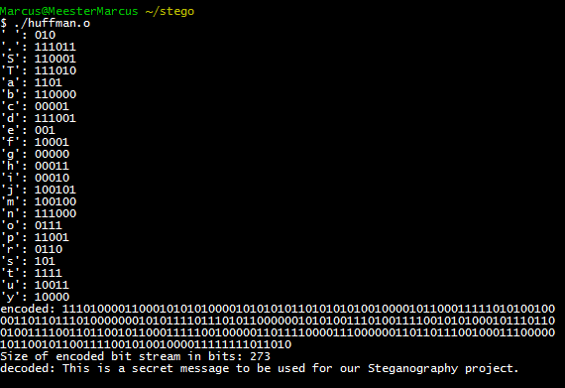
Sample output of Huffman.c

Slide 10
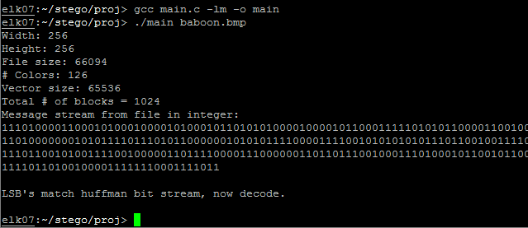
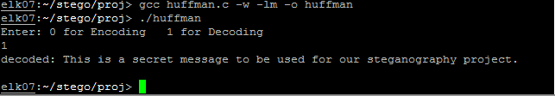
Output for main and huffman decode

Slide 11
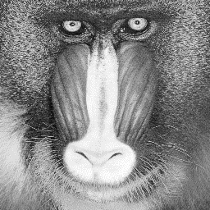

Images

Slide 12
The problems:
Hiding large amounts of data.
CASTING!!!

Slide 13
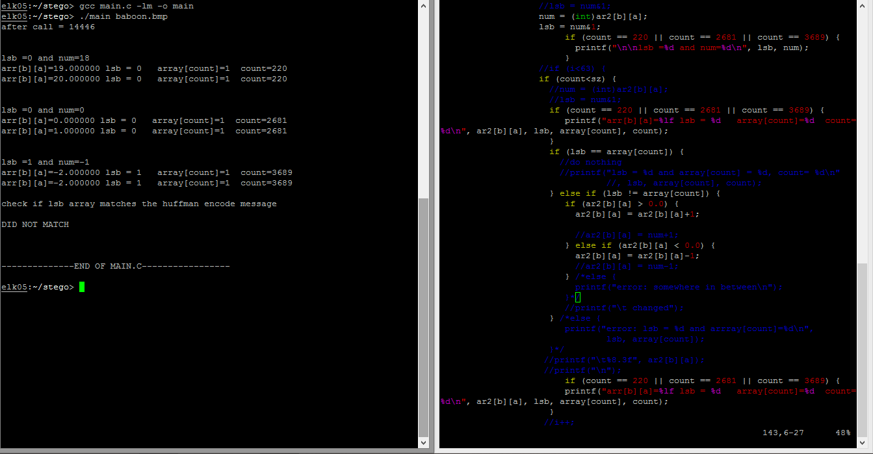
Casting Errors

Slide 14
Future Work
Have our program be able to hide large amounts of data.
Then be able to hide an image in our cover image.
Have the hidden information hide in permuted places in the 8x8 block as well as different blocks.

Slide 15
Bibliography
Nag, A., Biswas, S., Sarkar, D., & Sarkar, P. P. (0210, June 1). A novel technique for image steganography based on Block-DCT and Huffman Encoding. . Retrieved June 30, 2014, from http://arxiv.org/ftp/arxiv/papers/1006/1006.1186.pdf
Yang, C., & Wang, S. (2010, January 1). Transforming LSB Substitution for Image-based Steganography in Matching Algorithms. . Retrieved July 2, 2014, from http://www.iis.sinica.edu.tw/page/jise/2010/201007_03.pdf
Hamdy, S., El-Messiry, H., Roushdy, M., & Kahlifa, E. Retrieval of Bitmap Compression History. (IJCSIS) International Journal of Computer Science and Information Security, 8, 6. Retrieved July 10, 2014

